Slide 1
Installation of Apache, PHP & MySQL

Slide 2
Outline
In this tutorial, you will learn how to
  Install, configure & Test Apache
  Install, configure & Test PHP
  Install, configure & Test MySQL

Slide 3
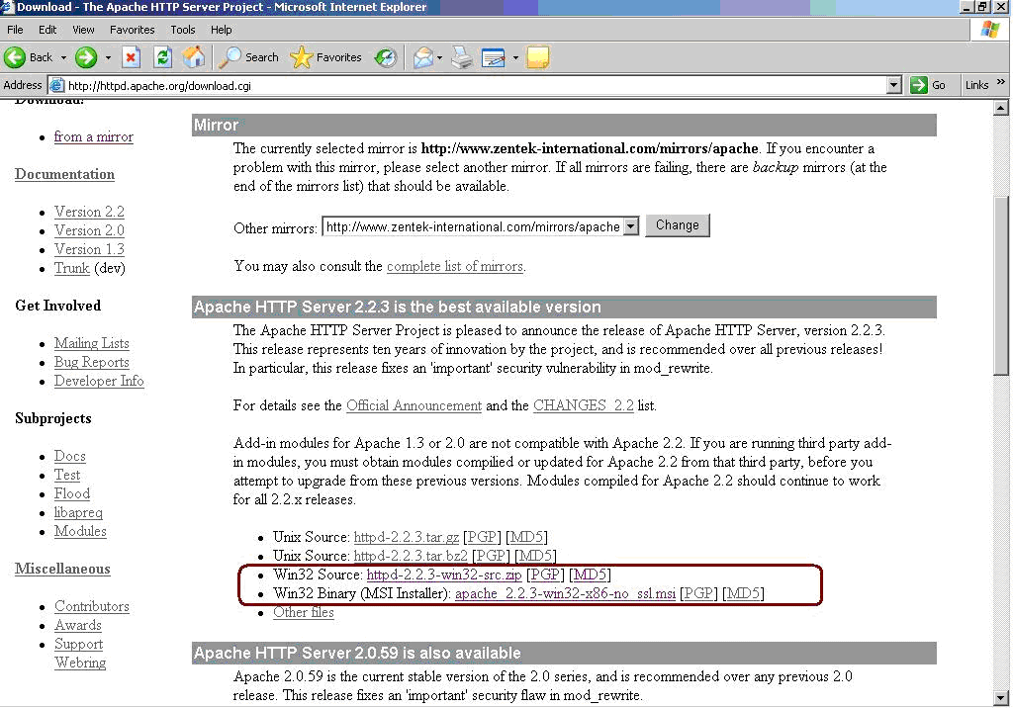
Installation of Apache
1. Download the Apache HTTP Server
The latest version is 2.2.3, download from Apache download page
(http://httpd.apache.org/download.cgi)
Windows: 3rd line: include source files, compile Apache source code
4th line: MSI installer package

Slide 4
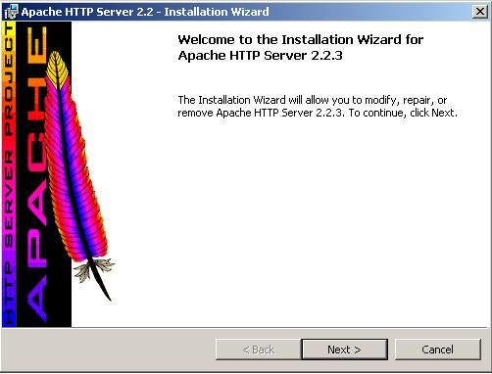
Installation of Apache
2. After you download the installer, double-click on the file
  apache_2.2.3-win32-x86-no_ssl.msi
start the installation process. You will get a welcome screen, as shown next:

Slide 5
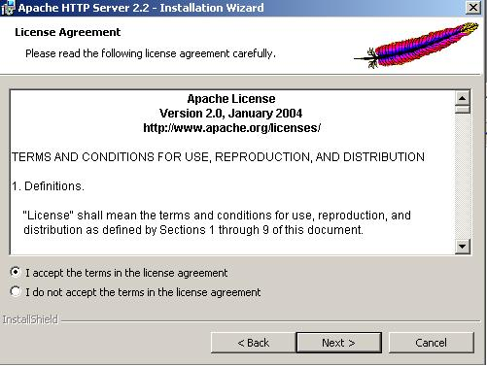
Installation of Apache
3. the Apache license screen
Select agree, click ”next”

Slide 6
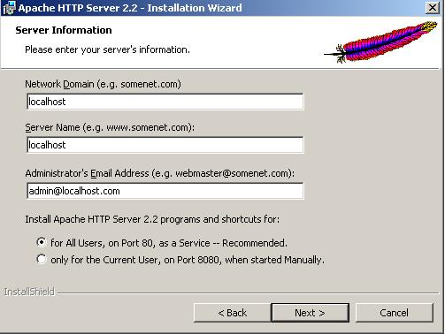
Installation of Apache
4. asks you to provide basic information about your computer
If your machine does not have a full network address, use localhost or 127.0.0.1 as the server name

Slide 7
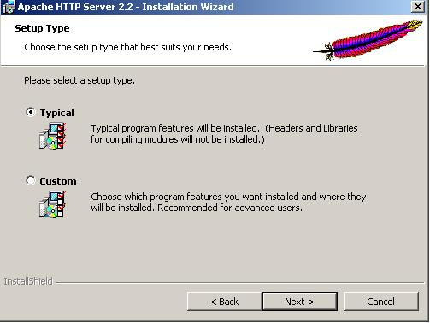
Installation of Apache
5. choose the type of installation
Typical installation: not install headers and libraries. Don’t plan to compile your own modules
Custom installation: Select whether to install header files or documentation, & the target installation directory

Slide 8
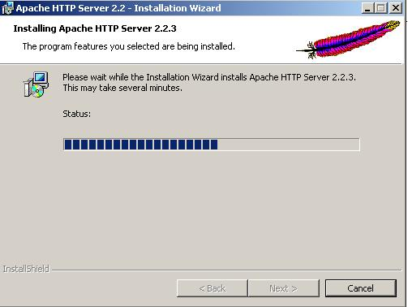
Installation of Apache
6. installation process

Slide 9
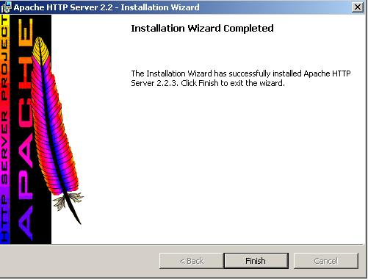
Installation of Apache
7. If everything goes well, it will present you with the final screen

Slide 10
Configuration of Apache
Apache keeps all of its configuration information in files.
Directories:
  Conf: main configuration file httpd.conf
  Htdocs: hold your web server
Httpd.conf
  Directives : configure specific settings of Apache, such as authorization, performance, and network parameters
  Containers: specify the context to which those settings refer.

Slide 11
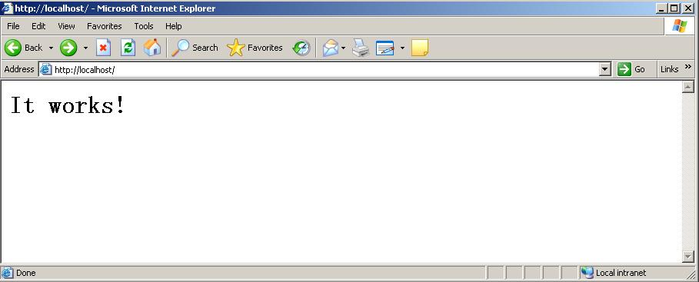
Test of Apache Server
Open the apache server
  programs->Apache HTTP Server 2.2.3->Control Apache Server->Start
If everything goes well, you can access Apache using a browser.
http://localhost/
The default installation page will be displayed

Slide 12
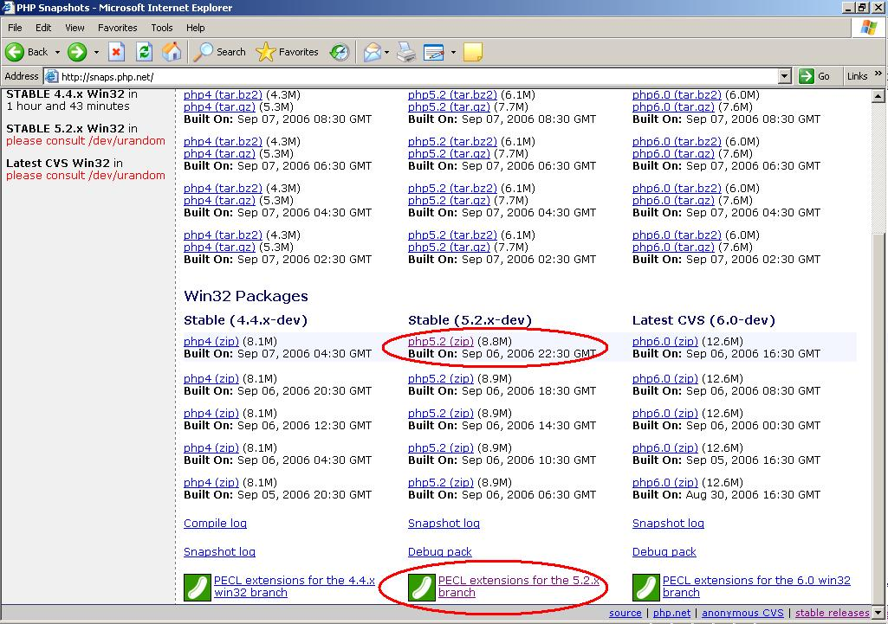
Installation of PHP
1. Download PHP package( http://snaps.php.net )
Be compatible with apache 2.2.x, download version of (5.2.x)
PECL extension: support more extensions

Slide 13
Installation of PHP
2. Unzip the download PHP file to installation directory
  (php5.2-win32-200609062230.zip) to “c:\PHP5”
3. Extract the PECL extension file to “c:\PHP5\ext\”.
  PECL is a repository for PHP Extensions, providing a directory of all known extensions and hosting facilities for downloading and development of PHP extensions.
  E.g. support C++, image processing …

Slide 14
Installation of PHP
4. Copy the dll file that will be used by the system in explaining and compiling the php files.
  Copy the php5ts.dll from “c:\PHP5” to “c:\windows”;(or “c:\winnt” in windows 2000 OS)
  Copy the following dll files from “c:\PHP5” to “c:\windows\system32”
    fdftk.dll
    fribidi.dll
    gds32.dll
    libeay32.dll
    libmhash.dll
    libmysql.dll
    ntwdblib.dll
    yaz.dll

Slide 15
Installation of PHP
5. Copy php.ini-dist file from “c:\php5” to “c:\windows”; and rename this file as “php.ini”. Edit this file using any edit tools, like Notepad.
Locate the lines of
; Directory in which the loadable extensions (modules) reside.
extension_dir = "./"
Modify the 2nd line to
extension_dir = "c:\PHP5\ext"
Save and close the file

Slide 16
Installation of PHP
6. Edit Apache configuration file to make the server can distinguish and use the correct compiler to PHP files.
Open httpd.conf:
Locate
DirectoryIndex index.html
Add php default page, normally as index.php
DirectoryIndex index.html index.php
In order to make Apache distinguish php and its corresponding extensions, Add the following 2 lines:
AddType application/x-httpd-php .php
AddType application/x-httpd-php-source .phps
Finally, the server should load the php module when it starts. So, add this line
LoadModule php5_module c:\PHP5\php5apache2_2.dll
OK, save the httpd.conf file, and restart Apache server.

Slide 17
Test of Apache & PHP
After the above setup, we can test whether the Apache server can distinguish and correctly compile the php file.
We can write a simple php file as:
  <?php
  phpinfo();
  ?>
Save as “test.php” into the server root directory.
  ....\Apache 2.2\htdocs (default)
Then open the browser, and type the address:
  http://localhost/test.php
If the php is installed correctly, you will see the following webpage:

Slide 18
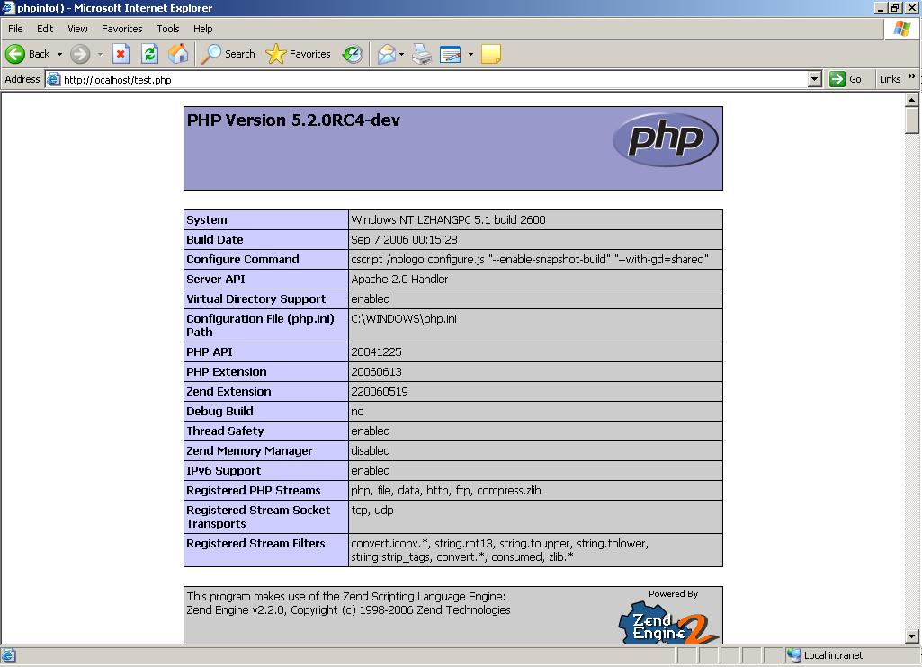
Test of Apache & PHP

Slide 19
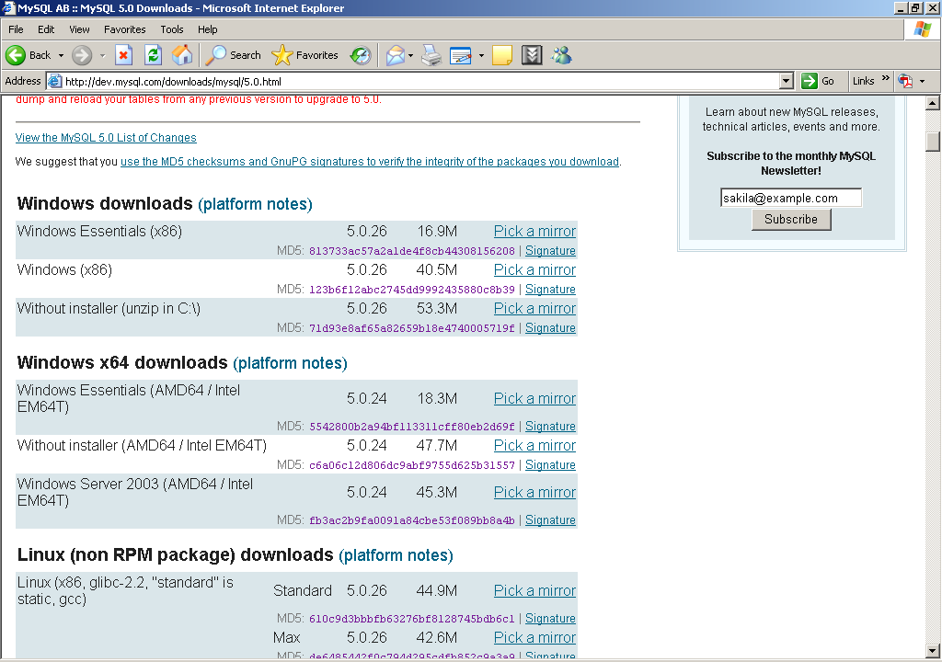
Installation of MySQL
1. Download MySQL setup file
  Current steady version: 5.0.26
  http://dev.mysql.com/downloads/mysql/5.0.html

Slide 20
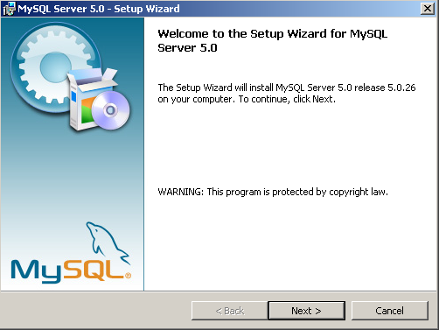
Installation of MySQL
2. After download, double click(mysql-essential-5.0.26-win31.msi)
Welcome screen

Slide 21
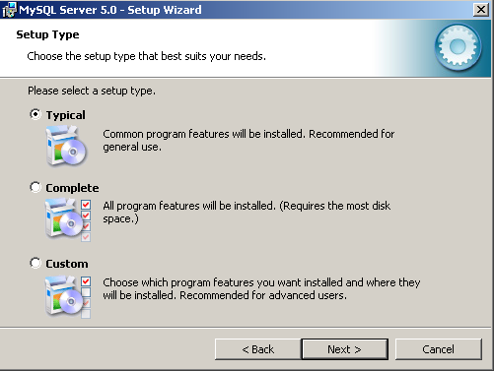
Installation of MySQL
3. Select setup type

Slide 22
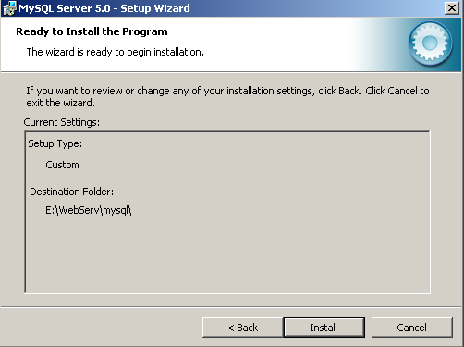
Installation of MySQL
4. Confirmation

Slide 23
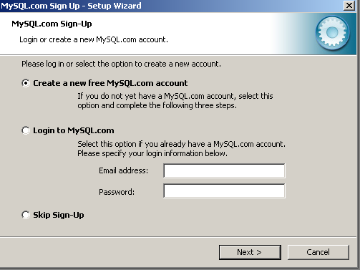
Installation of MySQL
5. sign up
After registration, you can access to post in the MySQL forums at forums.mysql.com along with the ability to report bugs at bugs.mysql.com and subscribe newsletter

Slide 24
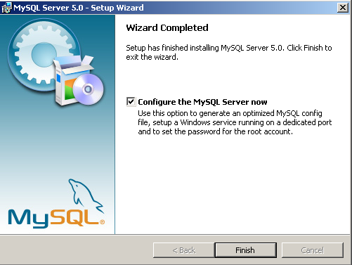
Installation of MySQL
6. Complete installation
7. start “Configuration the MySQL Server”

Slide 25
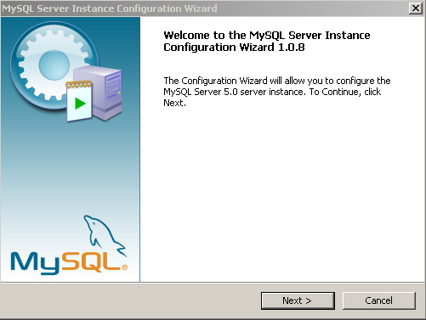
Configuration of MySQL
7.0 Welcome screen
  Launch the …\bin\MySQLInstanceConfig.exe
  Create a custom “my.ini” file by asking a series of questions

Slide 26
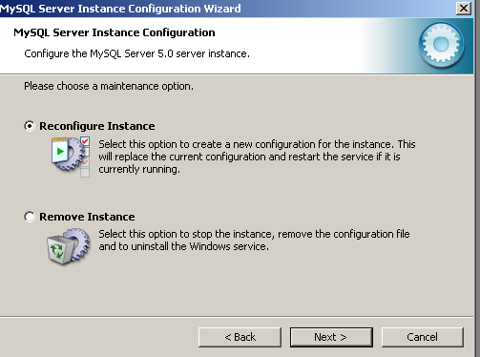
Configuration of MySQL
7.1 select a Maintenance Option type
Detects a existing “my.ini”, you have the option of either reconfiguring your existing server, or removing the server instance by deleting the “my.ini” file and stopping and removing the MySQL service

Slide 27
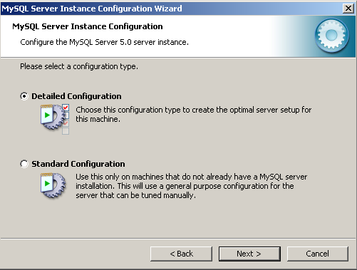
Configuration of MySQL
7.2 Choose a Configuration Type
  Standard: new users, quickly without having to make many decisions about server configuration. may be incompatible with systems with an existing MySQL installation), not recommend
  Detailed Configuration

Slide 28
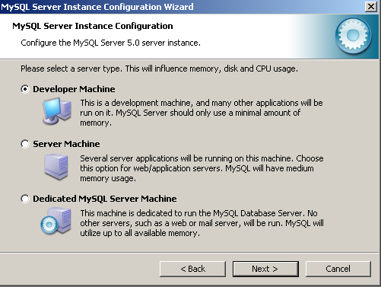
Configuration of MySQL
7.3 Server type (memory, disk and processor usage)
  Developer Machine :a typical desktop workstation, MySQL is only for personal use (minimal system resources)
  Server Machine :running alongside other server applications, such as FTP, email and Web servers (a moderate portion of the system resources)
  Dedicated MySQL Server Machine :run only the MySQL server (all available system resources)

Slide 29
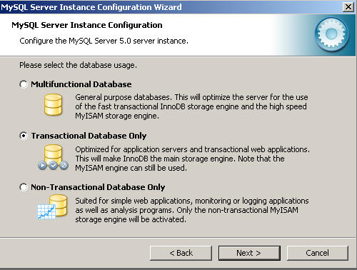
Configuration of MySQL
7.4 Select Database Usage
  indicate the storage engines used when creating MySQL tables. Determine whether the InnoDB storage engine is available and what percentage of server resources to it

Slide 30
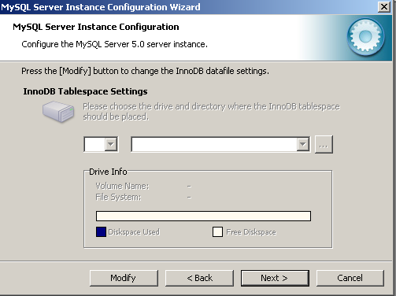
Configuration of MySQL
7.5 InnoDB tablespace setting
  Select a different location for InnoDB talbespace files than the MySQL server data directory (higher capacity or higher performance storage device available, e.g. RAID storage system)

Slide 31
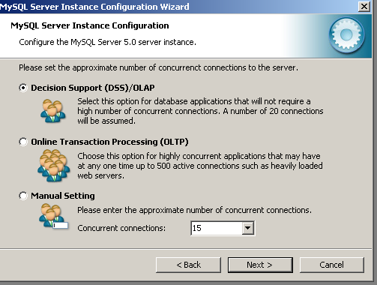
Configuration of MySQL
7.6 Concurrent connections
  Prevent the server from running out of resources, limit the number
  Decision Support :Maximum number of connections is set at 100, with an average of 20 concurrent connections assumed
  Online Transaction Processing :maximum number is 500
  Manual settings:

Slide 32
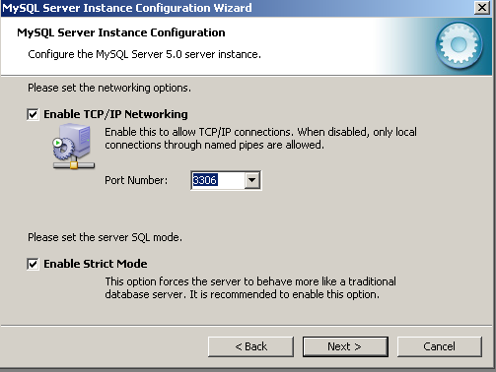
Configuration of MySQL
7.7 Networking and Strict Mode options
  Enable or disable TCP/IP networking, and to configurate the port number to connect to the MySQL server
  Strict mode: If you applications that rely on MySQL’s old “forgiving” behavior

Slide 33
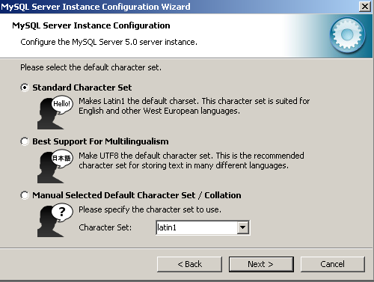
Configuration of MySQL
7.8 character set
  Select “Best Support For Multilingualism”(UTF8 store different characters )

Slide 34
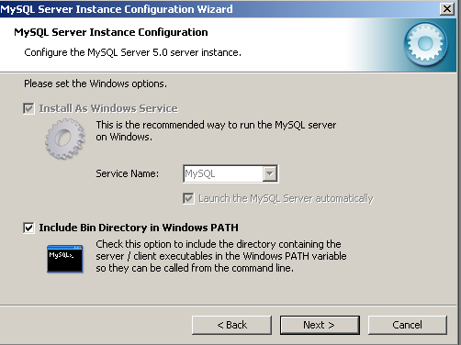
Configuration of MySQL
7.9 Service options
  Start automatically during system startup, even restarted automatically by Windows in service failure。
  Default name: MySQL, you can change the name, or uncheck the installation

Slide 35
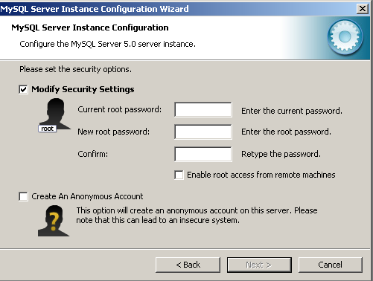
Configuration of MySQL
7.10 security option
  Set a root password for your MySQL
  Do not wish to set a root password, uncheck “Modify security settings”
  Create an anonymous user account, check the box

Slide 36
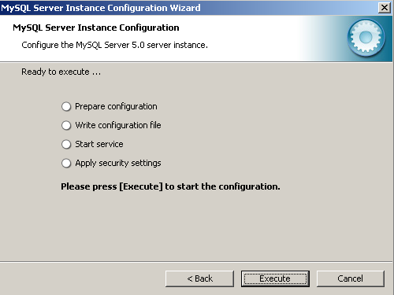
Configuration of MySQL
7.11 Confirmation, click Execute

Slide 37
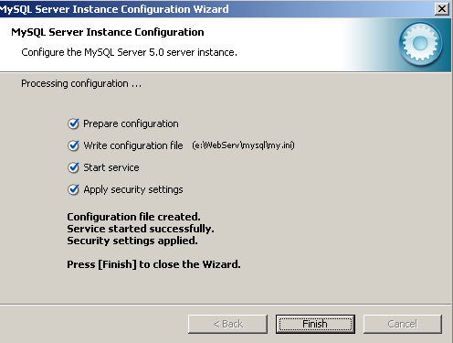
Configuration of MySQL
7.12 Finish
  If no problem, service started

Slide 38
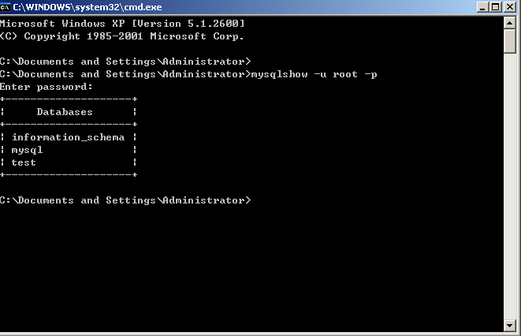
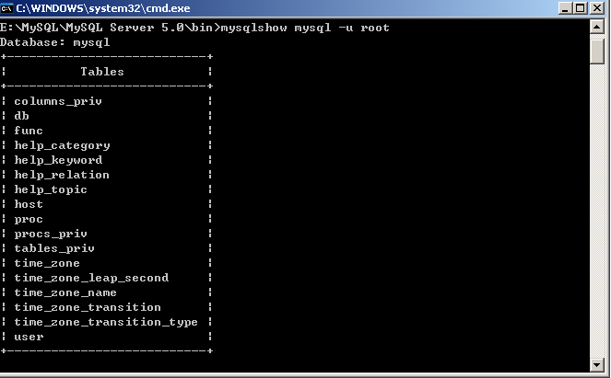
Test of MySQL
mysqlshow -u root –p // show the databases
mysqlshow mysql -u root –p //show tables in mysql

Slide 39
Useful toolset
MySQL GUI Tools Bundle for 5.0
  Provide a suite of desktop applications for the administration of MySQL instances and for building and manipulating the data within MySQL databases (http://dev.mysql.com/downloads/gui-tools/5.0.html)
  MySQL administrator 1.2
    Perform administrative operations, such as configuring, monitoring and starting/stopping a MySQL server, managing users and connections, backups…
  MySQL Query Browser 1.2
    Graphical tool for creating, executing and optimizing queries in a graphical environment
  MySQL Migration Toolkit 1.1
    Graphical tool for migrating schema and data from various relational database systems to MySQL
  MySQL Workbench 1.1
    Schema desin application that enables users to graphically design and modify tables and other database objects

